Slide 1
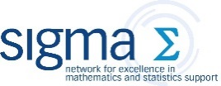

Quotations from famous mathematicians
This document was created as part of a wider sigma-funded project looking at promotional activities and resources for mathematics and statistics support centres.
For more information, email C.Voake-Jones@bath.ac.uk

Slide 2
Overview
This document contains quotations from famous mathematicians. Each quotation features on an individual slide, alongside the corresponding mathematician, and are listed in alphabetical order by surname. Quotations are great for social media, posters, leaflets, ….
There is little formatting to each quotation. You may wish to add images, such as a logo, or some text. Other possibilities include changing the font and background. Instructions on how to do this are given on slides 3 and 4.
For inspiration, some examples are given from slide 5 onwards. Explanatory notes are also included.
Quotations begin on slide 15.
Main source: http://www-history.mcs.st-and.ac.uk/

Slide 3

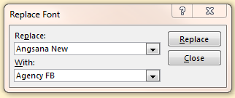
Tips
Replace all fonts:
Home
> Editing (Replace)
> Replace Fonts…

Slide 4
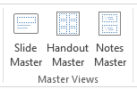

Tips
Add image or text to all slides:
View > Master Views (Slide Master)
Change background:
Home > Customize (Format Background)
Save slide(s) as image(s):
File > Save As > Save as type (choose gif, jpg, png, tif, or bmp)

Slide 5

The whole is more than the sum of its parts.
- Aristotle
Notes:
A geometric pattern as a background is eye-catching.
Make sure the pattern does not overwhelm the text or entire slide. Select the image, then Picture Tools > Format (Adjust). Change the colour, corrections and try the artistic effects.

Slide 6
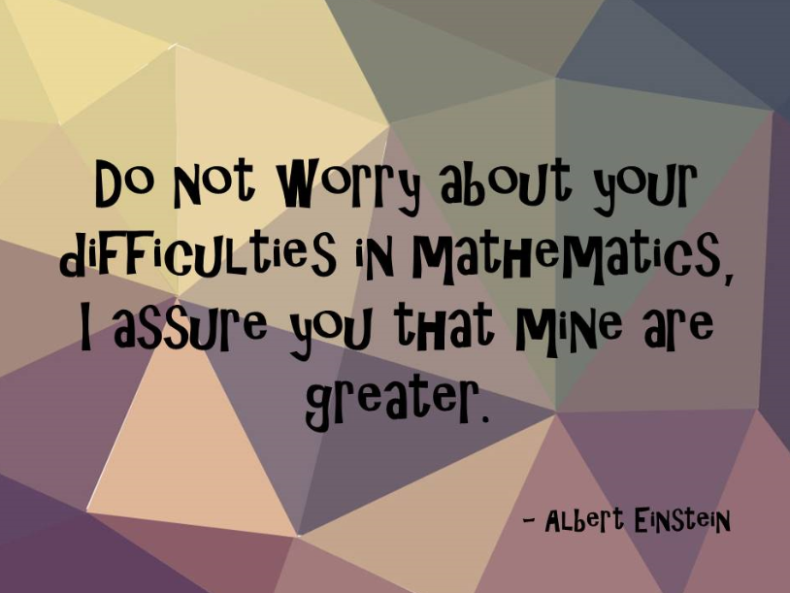
Notes:
A fun font to catch the eye

Slide 7
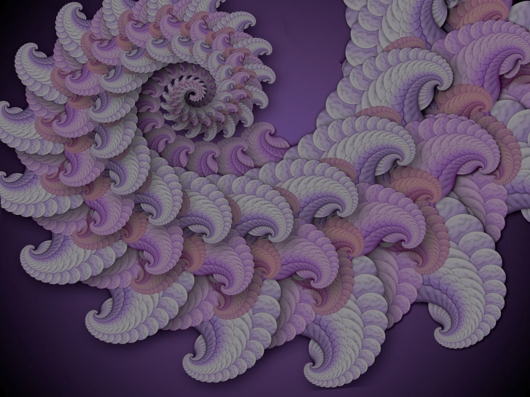
Mathemata mathematicis scribuntur.
Mathematics is written for mathematicians.
Copernicus
Notes:
Fractals are very eye-catching mathematical images.
The quotation in its original language adds extra information and depth.

Slide 8
The only way to LEARN mathematics, is to DO mathematics
- Paul Halmos

Slide 9
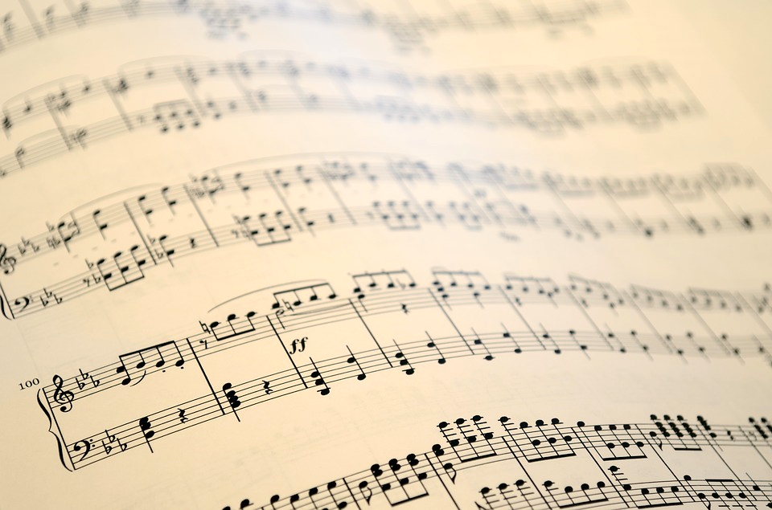
The pleasure we obtain from music comes from counting, but counting unconsciously.
Music is nothing but unconscious arithmetic.
- Leibniz
Notes:
Find a background image that is relevant to the quote.
A Google image search will usually suffice, but be sure to check the usage rights under Search tools.

Slide 10
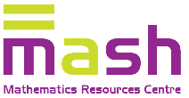
Maths quote of the week
If one is working from the point of view of getting beauty into one's equation, ...
one is on a sure line of progress.
Paul Dirac (1902-1984)
Notes:
Add your logo and other templating; then each month/week/day, you only need to update the quote.
The birth and death (if applicable) years add useful information, and a human side.

Slide 11
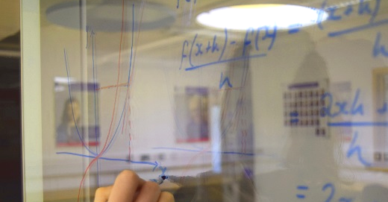
If I have been able to see further, it was only because I stood on the shoulders of giants.
- Isaac Newton
Notes:
Photos make great backgrounds.
Make sure the pattern does not overwhelm the text or entire slide. Select the image, then Picture Tools > Format (Adjust). Change the colour, corrections and try the artistic effects.

Slide 12
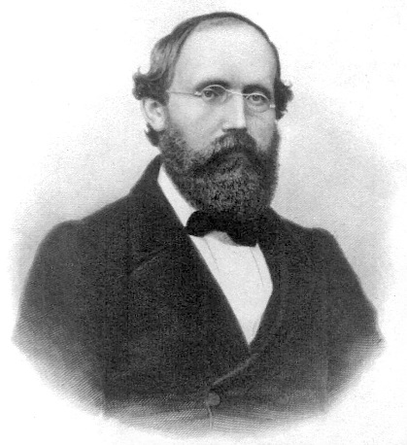
If only I had the theorems! Then I should find the proofs easily enough.
⬥ Bernhard Riemann 
Notes:
An image of the relevant brings the quotation to life and adds a human touch.
A Google image search will usually suffice, but be sure to check the usage rights under Search tools.

Slide 13
QUOTE OF THE DAY
“Life is good for only two things,
discovering mathematics
and teaching mathematics.”
- Poisson
Notes:
Change the colours to suit your own branding.

Slide 14
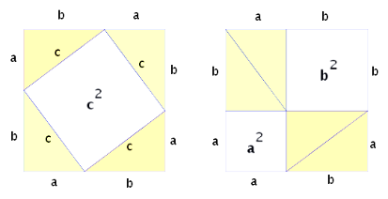
Number rules the universe.
~ Pythagoras
Notes:
Format the background with a pattern: Design (Customize) > Format Background.
Adding a mathematical image relating to the quotation or the mathematicians adds extra information and draws the eye. This image has been formatted to match the background colours, via Picture Tools > Format (Adjust) > Color.

Slide 15
The divergent series are the invention of the devil,
and it is a shame to base on them any demonstration whatsoever. By using them, one may draw any conclusion he pleases and that is why these series have produced so many fallacies and so many paradoxes...
Niels Abel

Slide 16
Once a sage asked why scholars always flock to the doors of the rich, whilst the rich are not inclined to call at the doors of scholars.
"The scholars" he answered , "are well aware of the use of money,
but the rich are ignorant of the nobility of science".
Abu Rayhan al-Biruni

Slide 17
A man can do all things
if he but wills them.
Leone Battista Alberti

Slide 18
Connaître, decouvrir, communiquer – telle est la destinée d'un savant.
To get to know, to discover, to publish – this is the destiny of scientist.
François Arago

Slide 19
Euler calculated without effort,
just as men breathe,
as eagles sustain themselves in the air.
François Arago

Slide 20
Give me a place to stand and I will move the earth.
Archimedes

Slide 21
The whole is more than the sum of its parts.
Aristotle

Slide 22
There are things which seem incredible to most men who have not studied mathematics.
Aristotle

Slide 23
That which we must learn to do,
we learn by doing.
Aristotle

Slide 24
Education is the best provision for old age.
Aristotle

Slide 25
It is the mark of an educated mind to be able to entertain a thought without accepting it.
Aristotle

Slide 26
This skipping is another important point.
It should be done whenever a proof seems too hard or whenever a theorem or a whole paragraph does not appeal to the reader.
In most cases he will be able to go on and later he may return to the parts which he skipped.
Emil Artin

Slide 27
Is it the fault of wine if a fool drinks it
and goes stumbling into darkness?
Ibn Sina / Avicenna

Slide 28
The errors which arise from the absence of facts are far more numerous and more durable than those which result from unsound reasoning respecting true data.
Charles Babbage

Slide 29
Et harum scientiarum porta et clavis est Mathematica.
Mathematics is the door and key to the sciences.
Roger Bacon

Slide 30
Mathematics is absolutely necessary and useful to the other sciences.
Roger Bacon

Slide 31
A little learning is a dangerous thing but none at all is fatal.
Roger Bacon

Slide 32
Prudens quaestio dimidium scientiae.
Half of science is asking the right questions.
Roger Bacon

Slide 33
The strongest arguments prove nothing so long as the conclusions are not verified by experience.
Experimental science is the queen of sciences
and the goal of all speculation.
Roger Bacon

Slide 34
Mathematics is the most beautiful and most powerful creation of the human spirit.
Mathematics is as old as man.
Stefan Banach

Slide 35
I recognise the lion by its claw.
[After reading an anonymous solution to a problem,
submitted by Newton]
Johann Bernoulli

Slide 36
How dare we speak of the laws of chance?
Is not chance the antithesis of all law?
Joseph Bertrand

Slide 37
I like to look at mathematics almost more as an art than as a science.
Maxime Bôcher

Slide 38
The science of numbers ought to be preferred as an acquisition before all others…
All sciences partake of it,
and it has need of none.
Boethius

Slide 39
An expert is a man who
has made all the mistakes,
which can be made,
in a very narrow field.
Niels Bohr

Slide 40
How wonderful that we have met with a paradox.
Now we have some hope of making progress.
Niels Bohr

Slide 41
Prediction is very difficult,
especially about the future.
Niels Bohr

Slide 42
Those who are not shocked
when they first come across
quantum mechanics
cannot possibly have understood it.
Niels Bohr

Slide 43
The opposite of a correct statement is a false statement.
But the opposite of a profound truth may well be another profound truth.
Niels Bohr

Slide 44
We are all agreed that your theory is crazy.
The question which divides us is whether it is crazy enough to have a chance of being correct. My own feeling is that it is not crazy enough.
Niels Bohr

Slide 45
Available energy is the main object
at stake in the struggle for existence
and the evolution of the world.
Ludwig Boltzmann

Slide 46
A mathematician will recognise Cauchy, Gauss, Jacobi or Helmholtz after reading a few pages, just as musicians recognise, from the first few bars, Mozart, Beethoven or Schubert.
Ludwig Boltzmann

Slide 47
My special pleasure in mathematics rested particularly on its purely speculative part.
Bernard Bolzano

Slide 48
No matter how correct a mathematical theorem may appear to be, one ought never to be satisfied that there was not something imperfect about it until it also gives the impression of being beautiful.
George Boole

Slide 49
Geometry measures the surface of a field without bothering to find if the soil is good or bad.
Émile Borel

Slide 50
I am now convinced that theoretical physics is actual philosophy.
Max Born

Slide 51
I believe there is no philosophical high-road in science, with epistemological signposts.
No, we are in a jungle and find our way by trial and error, building our road behind us as we proceed.
Max Born

Slide 52
So mathematical truth prefers simple words since the language of truth is itself simple.
Tycho Brahe

Slide 53
Mathematics is nothing more, nothing less, than the exact part of our thinking.
L E J Brouwer

Slide 54
The essence of mathematics lies in its freedom.
Georg Cantor

Slide 55
In mathematics the art of proposing a question must be held of higher value than solving it.
Georg Cantor

Slide 56
A set is a many that allows itself to be thought of as a one.
Georg Cantor

Slide 57
Men pass away,
but their deeds abide.
Augustin-Louis Cauchy

Slide 58
As for everything else, so for a mathematical theory: beauty can be perceived but not explained.
Arthur Cayley

Slide 59
In some strange way,
any new fact or insight that I may have found has not seemed to me as a discovery of mine,
but rather something that had always been there
and that I had chanced to pick up.
Subrahmanyan Chandrasekhar

Slide 60
To isolate mathematics from the practical demands of the sciences is to invite the sterility of a cow shut away from the bulls.
Pafnuty Chebyshev

Slide 61
The energy of the world is constant.
Its entropy tends to a maximum.
Rudolf Clausius

Slide 62
It is wrong always, everywhere,
and for anyone, to believe anything upon insufficient evidence.
William Clifford

Slide 63
Mathemata mathematicis scribuntur.
Mathematics is written for mathematicians.
Nicolaus Copernicus

Slide 64
Algebra is generous:
she often gives more than is asked for.
Jean d’Alembert

Slide 65
The moving power of mathematical invention is not reasoning but imagination.
Augustus De Morgan

Slide 66
It is easier to square the circle than to get round a mathematician.
Augustus De Morgan

Slide 67
[When asked about his age:]
I was x years old in the year x².
Augustus De Morgan

Slide 68
I don't quite hear what you say,
but I beg to differ entirely with you.
Augustus De Morgan

Slide 69
Numbers are the free creation of the human mind.
Richard Dedekind

Slide 70
Mathematics is the only instructional material that can be presented in an entirely undogmatic way.
Max Dehn

Slide 71
I would rather discover one scientific fact than become King of Persia.
Democritus

Slide 72
Nothing exists except atoms and empty space; everything else is opinion.
Democritus

Slide 73
Cogito Ergo Sum.
"I think, therefore I am."
René Descartes

Slide 74
Perfect numbers like perfect men are very rare.
René Descartes

Slide 75
It is not enough to have a good mind.
The main thing is to use it well.
René Descartes

Slide 76
When writing about transcendental issues,
be transcendentally clear.
René Descartes

Slide 77
This result is too beautiful to be false;
it is more important to have beauty in one's equations than to have them fit the experiment.
Paul Dirac

Slide 78
In science one tries to tell people,
in such a way as to be understood by everyone, something that no one ever knew before.
But in poetry, it's the exact opposite.
Paul Dirac

Slide 79
If one is working from the point of view of getting beauty into one's equation, ... one is on a sure line of progress.
Paul Dirac

Slide 80
The different branches of Arithmetic – Ambition, Distraction, Uglification, and Derision.
Charles Lutwidge Dodgson
(better known by his pseudonym, Lewis Carroll)

Slide 81
And since geometry is the right foundation of all painting, I have decided to teach its rudiments and principles
to all youngsters eager for art...
Albrecht Dürer

Slide 82
Proof is the idol before whom the pure mathematician tortures himself.
Arthur Eddington

Slide 83
We used to think that if we knew one, we knew two, because one and one are two.
We are finding that we must learn a great deal more about `and'.
Arthur Eddington

Slide 84
Shuffling is the only thing which nature cannot undo.
Arthur Eddington

Slide 85
The quest of the absolute leads into the four-dimensional world.
Arthur Eddington

Slide 86
If your theory is found to be against the second law of thermodynamics, I give you no hope; there is nothing for it but to collapse in deepest humiliation.
Arthur Eddington

Slide 87
I believe there are 15 747 724 136 275 002 577 605 653 961 181 555 468 044 717 914 527 116 709 366 231 425 076 185 631 031 296 protons in the universe and the same number of electrons.
Arthur Eddington

Slide 88
Everything should be made as simple as possible,
but not simpler.
Albert Einstein

Slide 89
Common sense is the collection of prejudices acquired by age eighteen.
Albert Einstein

Slide 90
Imagination is more important than knowledge.
Albert Einstein

Slide 91
God does not care about our mathematical difficulties.
He integrates empirically.
Albert Einstein

Slide 92
Do not worry about your difficulties in mathematics,
I assure you that mine are greater.
Albert Einstein

Slide 93
The truth of a theory is in your mind, not in your eyes.
Albert Einstein

Slide 94
These thoughts did not come in any verbal formulation. I rarely think in words at all.
A thought comes, and I may try to express it in words afterward.
Albert Einstein

Slide 95
Great spirits have always encountered violent opposition from mediocre minds.
Albert Einstein

Slide 96
If at first the idea is not absurd, then there is no hope for it.
Albert Einstein

Slide 97
The most incomprehensible fact about the universe is that it is comprehensible.
Albert Einstein

Slide 98
There are two ways to live your life.
One is as though nothing is a miracle.
The other is as though everything is a miracle.
Albert Einstein

Slide 99
Why are numbers beautiful?
It's like asking why is Beethoven's Ninth Symphony beautiful.
If you don't see why, someone can't tell you.
I know numbers are beautiful.
If they aren't beautiful, nothing is.
Paul Erdös

Slide 100
Why are you a physicist?
Why aren't you a mathematician?
Paul Erdös

Slide 101
God may not play dice with the universe,
but something strange is going on with the prime numbers.
Paul Erdös

Slide 102
The purpose of life is to prove and to conjecture.
Paul Erdös

Slide 103
There'll be plenty of time to rest in the grave.
Paul Erdös

Slide 104
There are three signs of senility.
The first sign is that a man forgets his theorems. The second sign is that he forgets to zip up.
The third sign is that he forgets to zip down.
Paul Erdös

Slide 105
The laws of mathematics are not merely human inventions or creations.
They simply ‘are’.
Maurits Escher

Slide 106
There is no royal road to geometry.
Euclid

Slide 107
Mathematicians have tried in vain to this day to discover some order in the sequence of prime numbers, and we have reason to believe that it is a mystery into which the human mind will never penetrate.
Leonhard Euler

Slide 108
[upon losing the use of his right eye]
Now I will have less distraction.
Leonhard Euler

Slide 109
All possible definitions of probability
fall short of the actual practice.
William Feller

Slide 110
And perhaps, posterity will thank me for having shown it that the ancients did not know everything.
Pierre Fermat

Slide 111
I think that I can safely say that nobody understands quantum mechanics.
Richard Feynman

Slide 112
For those who want some proof that physicists are human, the proof is in the idiocy of all the different units which they use for measuring energy.
Richard Feynman

Slide 113
To call in the statistician after the experiment is done may be no more than asking him to
perform a post-mortem examination:
he may be able to say what the experiment died of.
R A Fisher

Slide 114
The analysis of variance is not a mathematical theorem, but rather a convenient method of arranging the arithmetic.
R A Fisher

Slide 115
Natural selection is a mechanism for generating an exceedingly high degree of improbability.
R A Fisher

Slide 116
The profound study of nature is the most fertile source of mathematical discoveries.
Joseph Fourier

Slide 117
Mathematical analysis is as extensive as nature herself.
Joseph Fourier

Slide 118
Mathematics compares the most diverse phenomena and discovers the secret analogies that unite them.
Joseph Fourier

Slide 119
There is no royal road to mathematics.
Georg Frobenius

Slide 120
Measure what is measurable,
and make measurable what is not so.
Galileo Galilei

Slide 121
In questions of science,
the authority of a thousand is not worth the humble reasoning of a single individual.
Galileo Galilei

Slide 122
The laws of Nature are written in the language of mathematics ...
the symbols are triangles, circles and other geometrical figures, without whose help it is impossible to comprehend a single word.
Galileo Galilei

Slide 123
I have never met a man so ignorant that I couldn't learn something from him.
Galileo Galilei

Slide 124
All truths are easy to understand once they are discovered;
the point is to discover them.
Galileo Galilei

Slide 125
Unfortunately what is little recognised is that the most worthwhile scientific books are those in which the author clearly indicates what he does not know;
for an author most hurts his readers
by concealing difficulties.
Évariste Galois

Slide 126
You know that I write slowly.
This is chiefly because I am never satisfied until I have said as much as possible in a few words, and writing briefly takes far more time than writing at length.
Carl Friedrich Gauss

Slide 127
The total number of Dirichlet's publications is not large:
jewels are not weighed on a grocery scale.
Carl Friedrich Gauss

Slide 128
I have had my results for a long time: but I do not yet know how I am to arrive at them.
Carl Friedrich Gauss

Slide 129
Mathematics is the queen of the sciences and number theory is the queen of mathematics.
Carl Friedrich Gauss

Slide 130
I mean the word proof not in the sense of the lawyers,
who set two half proofs equal to a whole one,
but in the sense of a mathematician, where half proof = 0,
and it is demanded for proof that every doubt becomes impossible.
Carl Friedrich Gauss

Slide 131
Theory attracts practice
as the magnet attracts iron.
Carl Friedrich Gauss

Slide 132
There have been only three
epoch-making mathematicians,
Archimedes, Newton, and Eisenstein.
Carl Friedrich Gauss

Slide 133
The essence of mathematics is not to make simple things complicated,
but to make complicated things simple.
S Gudder

Slide 134
The only way to learn mathematics is to do mathematics.
Paul Halmos

Slide 135
The source of all great mathematics is the special case, the concrete example.
Paul Halmos

Slide 136
Mathematics is not a deductive science – that's a cliché.
When you try to prove a theorem, you don't just list the hypotheses, and then start to reason.
What you do is trial and error, experimentation, guesswork.
Paul Halmos

Slide 137
To be a scholar of mathematics
you must be born with talent, insight, concentration, taste, luck, drive
and the ability to visualise and guess.
Paul Halmos

Slide 138
When a student comes and asks,
"Should I become a mathematician?"
the answer should be no.
If you have to ask, you shouldn't even ask.
Paul Halmos

Slide 139
The library is the mathematician's laboratory.
Paul Halmos

Slide 140
Computers are important, but not to mathematics.
Paul Halmos

Slide 141
Applied mathematics will always need pure mathematics, just as anteaters will always need ants.
Paul Halmos

Slide 142
Feller was an ebullient man,
who would rather be wrong
than undecided.
Paul Halmos

Slide 143
... the student skit at Christmas contained a plaintive line: "Give us Master's exams that our faculty can pass,
or give us a faculty that can pass our Master's exams."
Paul Halmos

Slide 144
The mathematical fraternity is a little like a self-perpetuating priesthood.
The mathematicians of today teach the mathematicians of tomorrow and, in effect, decide whom to admit to the priesthood.
Paul Halmos

Slide 145
The heart of mathematics is its problems.
Paul Halmos

Slide 146
It saddens me that educated people don't even know that my subject exists.
Paul Halmos

Slide 147
I'd be glad to have written this book, and the next few times I talk to audiences I shall happily steal material from it.
Paul Halmos

Slide 148
A good stack of examples, as large as possible, is indispensable for a thorough understanding of any concept, and when I want to learn something new, I make it my first job to build one.
Paul Halmos

Slide 149
I am interested in mathematics only as a creative art.
G H Hardy

Slide 150
Young men should prove theorems,
old men should write books.
G H Hardy

Slide 151
Archimedes will be remembered when Aeschylus is forgotten, because languages die and mathematical ideas do not.
"Immortality" may be a silly word, but probably a mathematician has the best chance of whatever it may mean.
G H Hardy

Slide 152
In great mathematics there is a very
high degree of unexpectedness,
combined with inevitability and economy.
G H Hardy

Slide 153
Why should I refuse a good dinner simply because I don't understand the digestive processes involved.
-
[His reply when criticised for his use of operators before they could be justified formally.]
Oliver Heaviside

Slide 154
Logic can be patient, for it is eternal.
Oliver Heaviside

Slide 155
Euclid for children is barbarous.
Oliver Heaviside

Slide 156
This series is divergent, therefore we may be able to do something with it.
Oliver Heaviside

Slide 157
An expert is someone who knows some of the worst mistakes that can be made in his subject,
and how to avoid them.
Werner Heisenberg

Slide 158
Before beginning I should put in three years of intensive study, and I haven't that much time to squander on a probable failure.
-
[On why he didn't try to solve Fermat's last theorem]
David Hilbert

Slide 159
If I were to awaken after having slept for a thousand years,
my first question would be:
Has the Riemann hypothesis been proven?
David Hilbert

Slide 160
One can measure the importance of a scientific work by the number of earlier publications rendered superfluous by it.
David Hilbert

Slide 161
Every mathematical discipline goes through three periods of development: the naive, the formal, and the critical.
David Hilbert

Slide 162
Mathematics knows no races or geographic boundaries;
for mathematics, the cultural world is one country.
David Hilbert

Slide 163
A mathematical theory is not to be considered complete until you have made it so clear that you can explain it to the first man whom you meet on the street.
David Hilbert

Slide 164
The infinite!
No other question has ever moved so profoundly the spirit of man.
David Hilbert

Slide 165
One should always generalise.
Carl Jacobi

Slide 166
Mathematics exists solely for the honour of the human mind.
Carl Jacobi

Slide 167
Mathematics is the science of what is clear by itself.
Carl Jacobi

Slide 168
Thus, in a sense, mathematics has been most advanced by those who distinguished themselves by intuition rather than by rigorous proofs.
Felix Klein

Slide 169
Everyone knows what a curve is,
until he has studied enough mathematics
to become confused through the countless number of possible exceptions.
Felix Klein

Slide 170
The presentation of mathematics in schools should be psychological and not systematic.
The teacher, so to speak, should be a diplomat.
Felix Klein

Slide 171
Regarding the fundamental investigations of mathematics,
there is no final ending…
no first beginning.
Felix Klein

Slide 172
The theory of probability as a mathematical discipline can and should be developed from axioms in exactly the same way as geometry and algebra.
Andrey Kolmogorov

Slide 173
When we ask advice,
we are usually looking for an accomplice.
Joseph-Louis Lagrange

Slide 174
Read Euler:
he is our master in everything.
Pierre-Simon Laplace

Slide 175
Nature laughs at the difficulties of integration.
Pierre-Simon Laplace

Slide 176
What we know is not much.
What we do not know is immense.
Pierre-Simon Laplace

Slide 177
These tables [values of trigonometric functions] … are one of the most beautiful monuments
ever erected to science.
Adrien-Marie Legendre

Slide 178
Taking mathematics from the beginning
of the world to the time of Newton,
what he has done is much the better half.
Gottfried Leibniz

Slide 179
The imaginary number is a fine and wonderful resource of the human spirit,
almost an amphibian between
being and not being.
Gottfried Leibniz

Slide 180
The pleasure we obtain from music comes from counting, but counting unconsciously.
Music is nothing but unconscious arithmetic.
Gottfried Leibniz

Slide 181
[about him:]
It is rare to find learned men who are clean,
do not stink and have a sense of humour.
Gottfried Leibniz

Slide 182
Nothing is more important than to see the sources of invention which are,
in my opinion more interesting than the inventions themselves.
Gottfried Leibniz

Slide 183
No human investigation can be called real science if it cannot be demonstrated mathematically.
Leonardo da Vinci

Slide 184
There is no higher or lower knowledge, but one only, flowing out of experimentation.
Leonardo da Vinci

Slide 185
He who loves practice without theory is like the sailor who boards ship without a rudder and compass and never knows where he may cast.
Leonardo da Vinci

Slide 186
Mechanics is the paradise of the mathematical sciences, because by means of it one
comes to the fruits of mathematics.
Leonardo da Vinci

Slide 187
The first test of potential in mathematics is whether you can get anything out of geometry.
J E Littlewood

Slide 188
Try a hard problem.
You may not solve it,
but you will prove something else.
J E Littlewood

Slide 189
I listen only to Bach, Beethoven or Mozart.
Life is too short to waste on other composers.
J E Littlewood

Slide 190
I've been giving this lecture to first-year classes
for over twenty-five years.
You'd think they would begin to understand it by now.
J E Littlewood

Slide 191
Before creation God did just pure mathematics.
Then He thought it would be a
pleasant change to do some applied.
J E Littlewood

Slide 192
Mathematics is a dangerous profession;
an appreciable proportion of us goes mad.
J E Littlewood

Slide 193
The paper is very heavy going, and I should never have read it had I had not written it myself.
J E Littlewood

Slide 194
A linguist would be shocked to learn that if a set is not closed
this does not mean that it is open.
J E Littlewood

Slide 195
The infinitely competent can be uncreative.
J E Littlewood

Slide 196
A good mathematical joke is better, and better mathematics,
than a dozen mediocre papers.
J E Littlewood

Slide 197
I read in the proof sheets of Hardy on Ramanujan:
"As someone said, each of the positive integers was one of his personal friends."
My reaction was, "I wonder who said that; I wish I had."
In the next proof-sheets I read (what now stands),
"It was Littlewood who said..."
J E Littlewood

Slide 198
The Analytical Engine weaves algebraic patterns, just as the Jacquard loom weaves flowers and leaves.
Ada Lovelace

Slide 199
Being a language, mathematics may be used not only to inform but also, among other things, to seduce.
Benoit Mandelbrot

Slide 200
A cloud is made of billows upon billows upon billows that look like clouds. As you come closer to a cloud you don't get something smooth, but irregularities at a smaller scale.
Benoit Mandelbrot

Slide 201
Ampère was the
Newton of Electricity.
James Clerk Maxwell

Slide 202
The numbers may be said to rule the whole world of quantity, and the four rules of arithmetic may be regarded as the complete equipment of the mathematician.
James Clerk Maxwell

Slide 203
The mathematical education of the young physicist [Albert Einstein] was not very solid, which I am in a good position to evaluate since he obtained it from me in Zurich some time ago.
Hermann Minkowski

Slide 204
All I remember about the examination is that there was a question on Sturm's theorem about equations, which I could not do then and cannot do now.
Louis Mordell

Slide 205
There are two reasons why I propose to make myself thoroughly and unashamedly happy by talking about myself. The first is that on several occasions, both in England and America, I have been told that I am a legendary character.
Louis Mordell

Slide 206
Mathematical study and research are very suggestive of mountaineering. Whymper made several efforts before he climbed the Matterhorn in the 1860's and even then it cost the life of four of his party. Now, however, any tourist can be hauled up for a small cost, and perhaps does not appreciate the difficulty of the original ascent. So in mathematics, it may be found hard to realise the great initial difficulty of making a little step which now seems so natural and obvious, and it may not be surprising if such a step has been found and lost again.
Louis Mordell

Slide 207
When I was at Manchester, where there was a modern swimming pool, I was looked on as a great man, not for so trivial a reason as being an FRS, but because I used to dive off a five-metre board.
Louis Mordell

Slide 208
In 1912 I attended an international mathematical congress held in Cambridge. I went into the buffet room where all the distinguished mathematicians were gathered and I thought to myself, "What an odd looking lot they are."
Louis Mordell

Slide 209
Neither you nor I nor anybody else knows what makes a mathematician tick. It is not a question of cleverness. I know many mathematicians who are far abler than I am, but they have not been so lucky. An illustration may be given by considering two miners. One may be an expert geologist, but he does not find the golden nuggets that the ignorant miner does.
Louis Mordell

Slide 210
But mathematics is the sister, as well as the servant, of the arts and is touched by the same madness and genius.
Marston Morse

Slide 211
If I have been able to see further, it was only because I stood on the shoulders of giants.
Isaac Newton

Slide 212
The description of right lines and circles, upon which geometry is founded, belongs to mechanics. Geometry does not teach us to draw these lines, but requires them to be drawn.
Isaac Newton

Slide 213
The latest authors, like the most ancient, strove to subordinate the phenomena of nature to the laws of mathematics.
Isaac Newton

Slide 214
Truth is ever to be found in the simplicity, and not in the multiplicity and confusion of things.
Isaac Newton

Slide 215
In the absence of any other proof, the thumb alone would convince me of God's existence.
Isaac Newton

Slide 216
I will not define time, space, place and motion, as being well known to all.
Isaac Newton

Slide 217
I have made this letter longer than usual, because I lack the time to make it short.
Blaise Pascal

Slide 218
The more I see of men,
the better I like my dog.
Blaise Pascal

Slide 219
[to Fermat:]
Look somewhere else for someone who can follow you in your researches about numbers. For my part, I confess that they are far beyond me, and I am competent only to admire them.
Blaise Pascal

Slide 220
The last thing one knows when writing a book is what to put first.
Blaise Pascal

Slide 221
The excitement that a gambler feels when making a bet is equal to the amount he might win times the probability of winning it.
Blaise Pascal

Slide 222
Let no one say that I have said nothing new...
the arrangement of the subject is new.
When we play tennis, we both play with the same ball,
but one of us places it better.
Blaise Pascal

Slide 223
It is not certain that everything is uncertain.
Blaise Pascal

Slide 224
We arrive at truth, not by reason only, but also by the heart.
Blaise Pascal

Slide 225
Contradiction is not a sign of falsity,
nor the lack of contradiction a sign of truth.
Blaise Pascal

Slide 226
I cannot judge my work while I am doing it. I have to do as painters do, stand back and view it from a distance, but not too great a distance. How great? Guess.
Blaise Pascal

Slide 227
Everything that is written merely to please the author is worthless.
Blaise Pascal

Slide 228
We do not worry about being respected in towns through which we pass. But if we are going to remain in one for a certain time, we do worry. How long does this time have to be?
Blaise Pascal

Slide 229
Our notion of symmetry is derived form the human face. Hence, we demand symmetry horizontally and in breadth only, not vertically nor in depth.
Blaise Pascal

Slide 230
We are usually convinced more easily by reasons we have found ourselves than by those which have occurred to others.
Blaise Pascal

Slide 231
Statistics is the grammar of science.
Karl Pearson

Slide 232
If anybody says he can think about quantum problems without getting giddy, that only shows he has not understood the first thing about them.
Max Planck

Slide 233
His name stands magnificently over the portal of classical physics, and we can say this of him; by his birth James Clerk Maxwell belongs to Edinburgh, by his personality he belongs to Cambridge, by his work he belongs to the whole world.
Max Planck

Slide 234
The ludicrous state of solid geometry made me pass over this branch.
Plato

Slide 235
Mathematics is like draughts in being suitable for the young, not too difficult, amusing, and without peril to the state.
Plato

Slide 236
I have hardly ever known a mathematician who was capable of reasoning.
Plato

Slide 237
There still remain three studies suitable for free man. Arithmetic is one of them.
Plato

Slide 238
A wise man speaks because he has something to say;
a fool because he has to say something.
Plato

Slide 239
One of the penalties for refusing to participate in politics is that you end up being governed by your inferiors.
Plato

Slide 240
Mathematicians are born, not made.
Henri Poincaré

Slide 241
In the old days when people invented a new function they had something useful in mind. Now, they invent them deliberately just to invalidate our ancestors' reasoning, and that is all they are ever going to get out of them.
Henri Poincaré

Slide 242
Point set topology is a disease from which the human race will soon recover.
Henri Poincaré

Slide 243
Science is built up with facts, as a house is with stones. But a collection of facts is no more a science than a heap of stones is a house.
Henri Poincaré

Slide 244
Mathematicians do not study objects, but relations between objects. Thus, they are free to replace some objects by others so long as the relations remain unchanged.
Content to them is irrelevant: they are interested in form only.
Henri Poincaré

Slide 245
It may happen that small differences in the initial conditions produce very great ones in the final phenomena.
Henri Poincaré

Slide 246
Zero is the number of objects that satisfy a condition that is never satisfied. But as never means "in no case", I do not see that any progress has been made.
Henri Poincaré

Slide 247
Life is good for only two things, discovering mathematics
and teaching mathematics.
Siméon-Denis Poisson

Slide 248
The traditional mathematics professor of the popular legend is absentminded.
He usually appears in public with a lost umbrella in each hand.
He prefers to face a blackboard and to turn his back on the class.
He writes a, he says b, he means c, but it should be d.
George Pólya

Slide 249
The first rule of discovery is to have brains and good luck. The second rule of discovery is to sit tight and wait till you get a bright idea.
George Pólya

Slide 250
The elegance of a mathematical theorem is directly proportional to the number of independent ideas one can see in the theorem and inversely proportional to the effort it takes to see them.
George Pólya

Slide 251
Mathematics is the cheapest science.
Unlike physics or chemistry, it does not require any expensive equipment.
All one needs for mathematics is a pencil and paper.
George Pólya

Slide 252
There are many questions which fools can ask that wise men cannot answer.
George Pólya

Slide 253
Mathematics consists of proving the most obvious thing in the least obvious way.
George Pólya

Slide 254
John von Neumann was the only student I was ever afraid of.
George Pólya

Slide 255
A mathematician who can only generalise is like a monkey who can only climb up a tree,
and a mathematician who can only specialise is like a monkey who can only climb down a tree.
In fact neither the up monkey nor the down monkey is a viable creature.
A real monkey must find food and escape his enemies
and so must be able to incessantly climb up and down.
A real mathematician must be able to generalise and specialise.
George Pólya

Slide 256
If there is a problem you can't solve, then there is an easier problem you can solve: find it.
George Pólya

Slide 257
Look around when you have got your first mushroom or made your first discovery: they grow in clusters.
George Pólya

Slide 258
Number rules the universe.
Pythagoras

Slide 259
Geometry is knowledge of the eternally existent.
Pythagoras

Slide 260
As soon as laws are necessary for men, they are no longer fit for freedom.
Pythagoras

Slide 261
The more progress physical sciences make, the more they tend to enter the domain of mathematics, which is a kind of centre to which they all converge. We may even judge the degree of perfection to which a science has arrived by the facility with which it may be submitted to calculation.
Adolphe Quetelet

Slide 262
Besides the mathematical arts there is no infallible knowledge, except that it be borrowed from them.
Robert Recorde

Slide 263
You, who wish to study great and wonderful things, who wonder about the movement of the stars, must read these theorems about triangles. Knowing these ideas will open the door to all of astronomy and to certain geometric problems.
Johann Müller Regiomontanus

Slide 264
If only I had the theorems! Then I should find the proofs easily enough.
Bernhard Riemann

Slide 265
Julia Robinson's Job Description [a tribute by Elizabeth Scott]:
Monday: | Try to prove theorem
Tuesday: | Try to prove theorem
Wednesday: | Try to prove theorem
Thursday: | Try to prove theorem
Friday: | Theorem false
Julia Bowman Robinson

Slide 266
Mathematics takes us into the region of absolute necessity, to which not only the actual word, but every possible word, must conform.
Bertrand Russell

Slide 267
Although this may seem a paradox, all exact science is dominated by the idea of approximation.
Bertrand Russell

Slide 268
At the age of eleven, I began Euclid, with my brother as my tutor. This was one of the great events of my life, as dazzling as first love. I had not imagined there was anything so delicious in the world. From that moment until I was thirty-eight, mathematics was my chief interest and my chief source of happiness.
Bertrand Russell

Slide 269
At first it seems obvious, but the more you think about it the stranger the deductions from this axiom seem to become; in the end you cease to understand what is meant by it.
Bertrand Russell

Slide 270
Calculus required continuity, and continuity was supposed to require the infinitely little; but nobody could discover what the infinitely little might be.
Bertrand Russell

Slide 271
The method of "postulating" what we want has many advantages; they are the same as the advantages of theft over honest toil.
Bertrand Russell

Slide 272
Aristotle maintained that women have fewer teeth than men; although he was twice married, it never occurred to him to verify this statement by examining his wives' mouths.
Bertrand Russell

Slide 273
Work is of two kinds: first, altering the position of matter at or near the earth's surface relatively to other such matter; second, telling other people to do so. The first kind is unpleasant and ill paid; the second is pleasant and highly paid.
Bertrand Russell

Slide 274
The desire to understand the world and the desire to reform it are the two great engines of progress.
Bertrand Russell

Slide 275
[Upon hearing an explanation of the theory of relativity:]
To think I have spent my life on absolute muck.
Bertrand Russell

Slide 276
The whole problem with the world is that fools and fanatics are always so certain of themselves, but wiser people so full of doubts.
Bertrand Russell

Slide 277
The point of philosophy is to start with something so simple as not to seem worth stating, and to end with something so paradoxical that no one will believe it.
Bertrand Russell

Slide 278
[On quantum mechanics:]
I don't like it, and I'm sorry I ever had anything to do with it.
Erwin Schrödinger

Slide 279
Mathematics is more than an art form.
Takakazu Seki

Slide 280
The mathematical literature is useful in that it provides clues, and one can often use these clues to put together a cogent picture. When I have reorganised the mathematics in my own terms, then I feel an understanding, not before.
Stephen Smale

Slide 281
For Bourbaki, Poincaré was the devil incarnate.
For students of chaos and fractals,
Poincaré is of course God on Earth.
Marshall Stone

Slide 282
Mathematics is the music of reason.
James Joseph Sylvester

Slide 283
The early study of Euclid made me a hater of geometry.
James Joseph Sylvester

Slide 284
All roads are said to lead to Rome, so I find, in my own case at least, that all algebraical inquiries sooner or later end at that Capital of Modern Algebra over whose shining portal is inscribed "Theory of Invariants".
James Joseph Sylvester

Slide 285
May not music be described as the mathematics of the sense, mathematics as music of the reason? The musician feels mathematics, the mathematician thinks music: music the dream, mathematics the working life.
James Joseph Sylvester

Slide 286
Algebra is rich in structure but weak in meaning.
René Thom

Slide 287
If one must choose between rigour and meaning,
I shall unhesitatingly choose the latter.
René Thom

Slide 288
The importance of the "New Mathematics" lies mainly in the fact that it has taught us the difference between the disc and the circle.
René Thom

Slide 289
I believe that proving is not a natural activity for mathematicians.
René Thom

Slide 290
When you measure what you are speaking about and express it in numbers, you know something about it, but when you cannot express it in numbers your knowledge about is of a meagre and unsatisfactory kind.
William Thomson

Slide 291
Fourier is a mathematical poem.
William Thomson

Slide 292
Do not imagine that mathematics is hard and crabbed, and repulsive to common sense.
It is merely the etherialisation of common sense.
William Thomson

Slide 293
Experimentation is unnecessary for the student.
The student should be prepared to accept whatever the master told him.
Isaac Todhunter

Slide 294
[On being asked whether he would like to see an experimental demonstration of conical refraction:]
No. I have been teaching it all my life, and I do not want to have my ideas upset.
Isaac Todhunter

Slide 295
The best thing about being a statistician is that you get to play in everyone's backyard.
John Tukey

Slide 296
If we need a short suggestion of what exploratory
data analysis is, I would suggest that
It is an attitude AND
A flexibility AND
Some graph paper (or transparencies, or both).
John Tukey

Slide 297
Far better an approximate answer to the right question, which is often vague, than the exact answer to the wrong question, which can always be made precise.
John Tukey

Slide 298
Machines take me by surprise with great frequency.
Alan Turing

Slide 299
A computer would deserve to be called intelligent if it could deceive a human into believing that it was human.
Alan Turing

Slide 300
The infinite we shall do right away.
The finite may take a little longer.
Stan Ulam

Slide 301
Knowing what is big and what is small is more important than being able to solve partial differential equations.
Stan Ulam

Slide 302
Any good idea can be stated in fifty words or less.
Stan Ulam

Slide 303
Do not lose your faith.
A mighty fortress is our mathematics. Mathematics will rise to the challenge,
as it always has.
Stan Ulam

Slide 304
Quod est, Nullum non problema solvere.
There is no problem that cannot be solved.
François Viète

Slide 305
There is a certain way of searching for the truth in mathematics that Plato is said first to have discovered. Theon called this analysis.
François Viète

Slide 306
In mathematics you don't understand things. You just get used to them.
John von Neumann

Slide 307
Anyone who considers arithmetic methods of producing random digits is, of course, in a state of sin.
John von Neumann

Slide 308
All stable processes we shall predict. All unstable processes we shall control.
John von Neumann

Slide 309
[In 1949:]
It would appear that we have reached the limits of what it is possible to achieve with computer technology, although one should be careful with such statements, as they tend to sound pretty silly in 5 years.
John von Neumann

Slide 310
There's no sense in being precise when you don't even know what you're talking about.
John von Neumann

Slide 311
If people do not believe that mathematics is simple, it is only because they do not realise how complicated life is.
John von Neumann

Slide 312
It is true that a mathematician who is not also something of a poet will never be a perfect mathematician.
Karl Weierstrass

Slide 313
My work has always tried to unite the true with the beautiful and when I had to choose one or the other, I usually chose the beautiful.
Hermann Weyl

Slide 314
Logic is the hygiene the mathematician practices to keep his ideas healthy and strong.
Hermann Weyl

Slide 315
Mathematics has been called the science of the infinite. Indeed, the mathematician invents finite constructions by which questions are decided that by their very nature refer to the infinite. This is his glory.
Hermann Weyl

Slide 316
In these days the angel of topology and the devil of abstract algebra fight for the soul of every individual discipline of mathematics.
Hermann Weyl

Slide 317
The science of pure mathematics ... may claim to be the most original creation of the human spirit.
Alfred North Whitehead

Slide 318
Everything of importance has been said before by somebody who did not discover it.
Alfred North Whitehead

Slide 319
We think in generalities, but we live in details.
Alfred North Whitehead

Slide 320
Familiar things happen, and mankind does not bother about them. It requires a very unusual mind to undertake the analysis of the obvious.
Alfred North Whitehead

Slide 321
It is a safe rule to apply that, when a mathematical or philosophical author writes with a misty profundity, he is talking nonsense.
Alfred North Whitehead

Slide 322
Let us grant that the pursuit of mathematics is a divine madness of the human spirit.
Alfred North Whitehead

Slide 323
Now in creative thought common sense is a bad master. Its sole criterion for judgement is that the new ideas shall look like the old ones. In other words it can only work by suppressing originality.
Alfred North Whitehead

Slide 324
I regret that it has been necessary for me in this lecture to administer a large dose of four-dimensional geometry. I do not apologise, because I am really not responsible for the fact that nature in its most fundamental aspect is four-dimensional. Things are what they are ...
Alfred North Whitehead

Slide 325
Education is the acquisition of the art of the utilisation of knowledge.
Alfred North Whitehead

Slide 326
The British Mathematical Colloquium consists of three days of mathematics with no dogs and no wives.
Henry Whitehead

Slide 327
Mathematics... is a bit like discovering oil. ... But mathematics has one great advantage over oil, in that no one has yet ... found a way that you can keep using the same oil forever.
Andrew Wiles

Slide 328
There can never be surprises in logic.
Ludwig Wittgenstein

Slide 329
The riddle does not exist.
If a question can be put at all,
then it can also be answered.
Ludwig Wittgenstein

Slide 330
Everything that can be said, can be said clearly.
Ludwig Wittgenstein

Slide 331
All mathematics is tautology.
Ludwig Wittgenstein

Slide 332
The process of calculating brings about just this intuition. Calculation is not an experiment.
Ludwig Wittgenstein

Slide 333
With my full philosophical rucksack I can only climb slowly up the mountain of mathematics.
Ludwig Wittgenstein

Slide 334
We could present spatially an atomic fact which contradicted the laws of physics, but not one which contradicted the laws of geometry.
Ludwig Wittgenstein

Slide 335
Mathematical demonstrations being built upon the impregnable foundations of geometry and arithmetic are the only truths that can sink into the mind of man, void of all uncertainty.
Christopher Wren

Slide 336
Isn't it extraordinary how difficult it is to get a sample really random? Every possible precaution, as it may seem, sometimes fails to protect one. … in some experiments done by drawing different coloured counters from a bag, there seemed to be a bias against one particular colour. On testing … this colour had given the counters a slightly greasy surface, so that it tended to escape the sampler's fingers ...
George Udny Yule

